Slide 1
Module 3
Building AI Agents with AutoGen

Slide 2
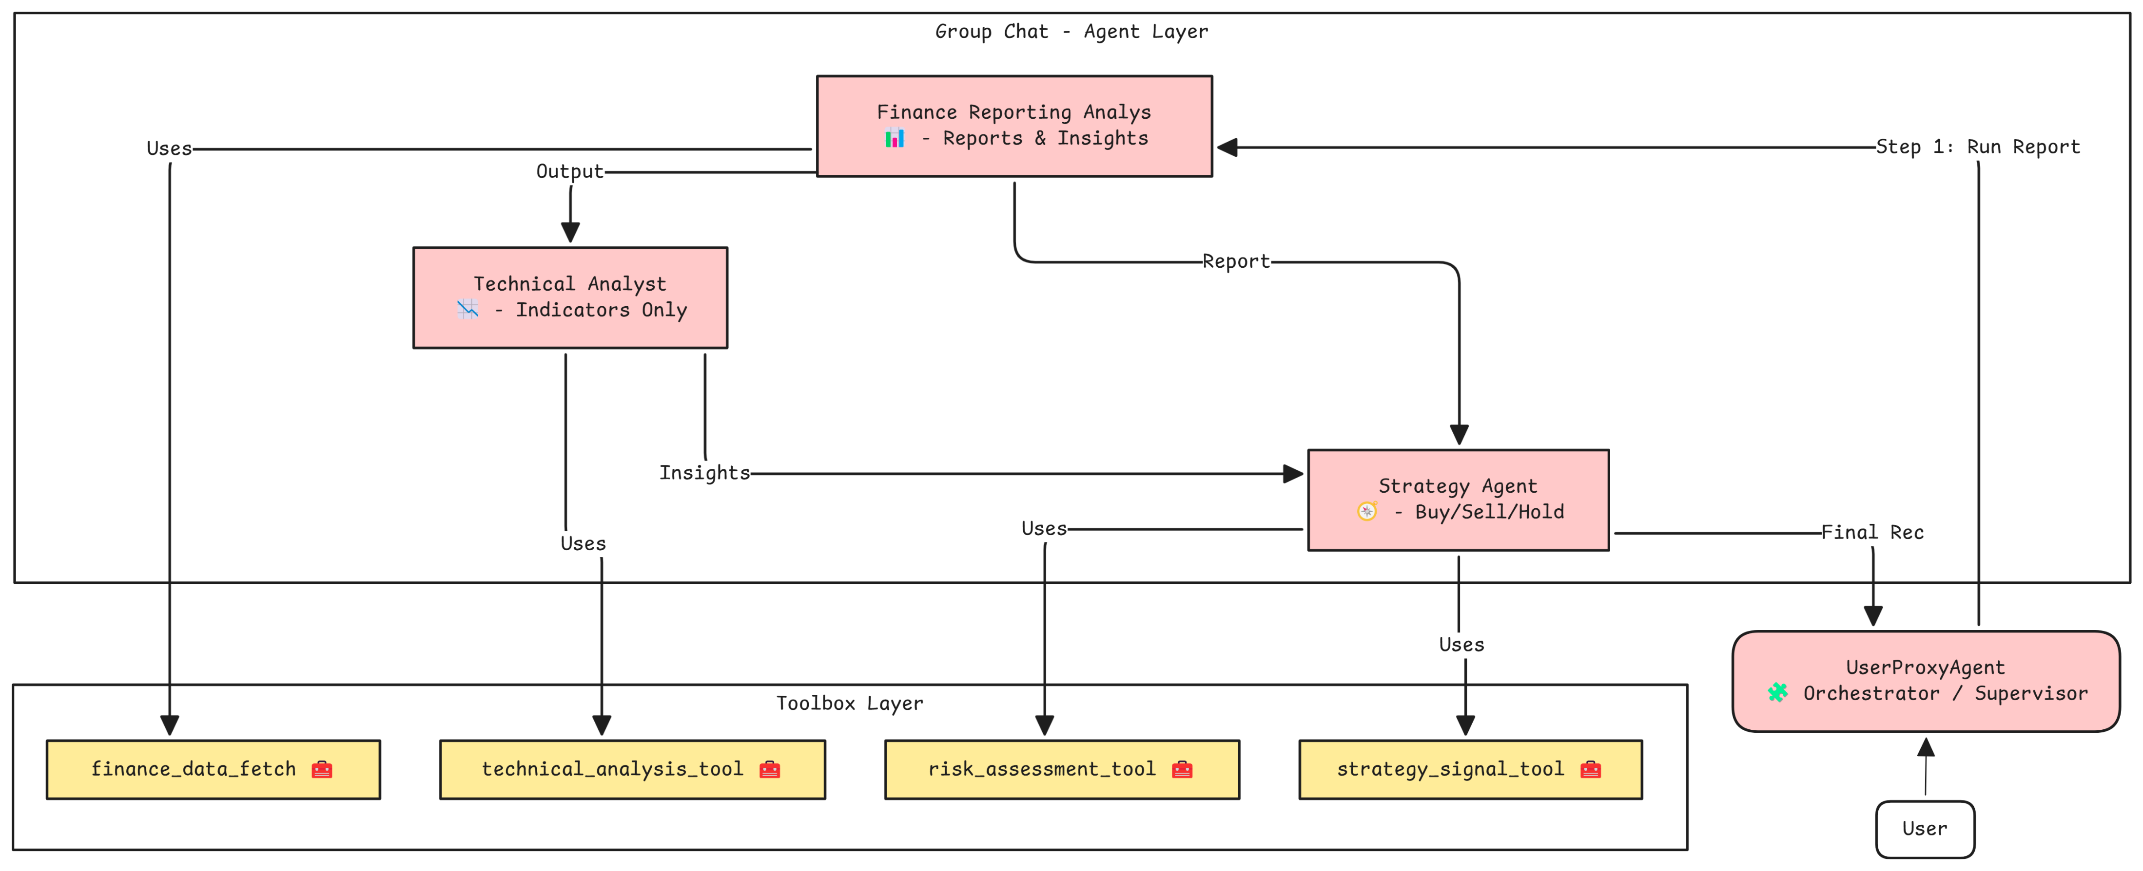
Agents and Tools for Financial Analysis

Slide 3
Agent 4 – Orchestrator (UserProxyAgent)
Role: Coordinates the overall workflow
Responsibilities:
Initiates the reporting agent for data and analysis
Passes output to reporting agent and technical analyst
Invokes strategy agent with combined inputs
Presents a final summary to the user
Rules:
Do not invent information
Use only available tools and agent outputs
Handle failures gracefully

